Slide 1
Capstone Project
Online Retail Customer Segmentation Prepared By – Pradeep Gupta

Slide 2
Problem Statement
The company mainly sells unique all occasion gifts. Many customers of the company are wholesalers. In this project our task is to identify major customer segments on a transnational data set which contains all the transactions occurring between 01-12-2010 and 09-12-2011 for a UK based and registered non store online retail.

Slide 3
Points of discussion
Data summary
Handling null and duplicated values
Data Cleaning
Feature Engineering
Exploratory data analysis
Elbow plot to find number of clusters
Dendrogram
Silhouette Score
Conclusion

Slide 4
Data Summary
Data set name- Online Retail Customer Segmentation
Shape of dataset- 541909 Rows, 8 Columns
Columns-
InvoiceNo - A 6-digit integral number uniquely assigned to each transaction. If this code starts with letter ‘C’, it indicates a cancellation.
StockCode – A 5-digit integral number uniquely assigned to each distinct product.
Description – Product name.
Quantity – The quantity of each product per transaction
InvoiceDate – The day and time when each transaction was generated.
UnitPrice – Product price per unit in sterling.
CustomerId – A 5-digtit number uniquely assigned to each customer resides.
Country – The name of the country where each customer resides.

Slide 5
Data Cleaning
Duplicated Values – Dataset had 5268 duplicated values, I dropped the duplicated values.
Null Values – Two columns ‘Description’ and ‘Customer ID’ contains null values so I dropped those null values.
Cancelled Items – Total 8872 items were cancelled, I dropped cancelled items.
Shape of dataset – 392732 Rows, 8 Columns
Feature Engineering
Extracted Day name, Month name, Year and Hour from Invoice Date.
Created a new Feature TotalAmount by multiplying Quantity and Unit Price.

Slide 6
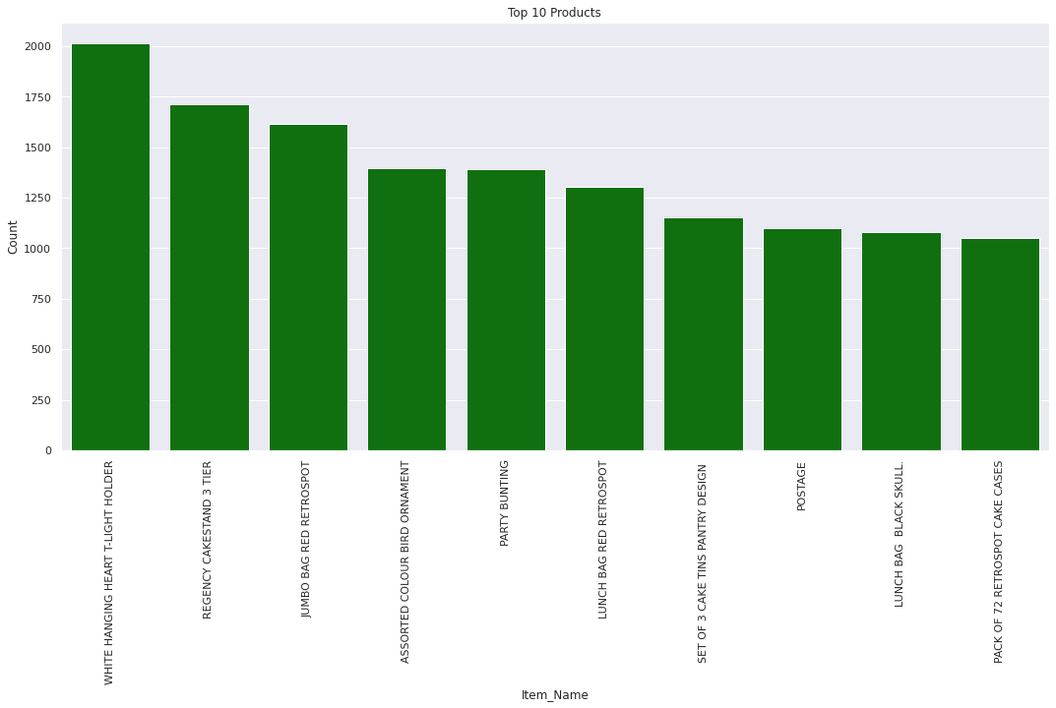
Top Selling Products
Top selling items are ‘White hanging heart t-light holder’, ‘Regency cakestand 3 tier’, ‘Jumbo bag red retrospot’ and ‘Assorted color bird ornament’.

Slide 7
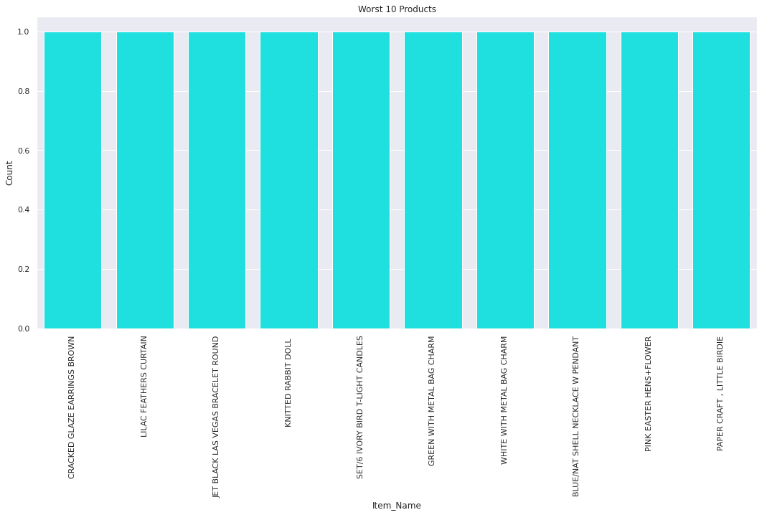
Worst selling products

Slide 8
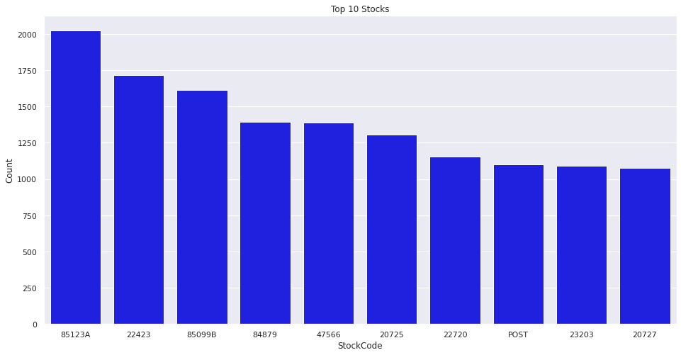
Top Stocks

Slide 9
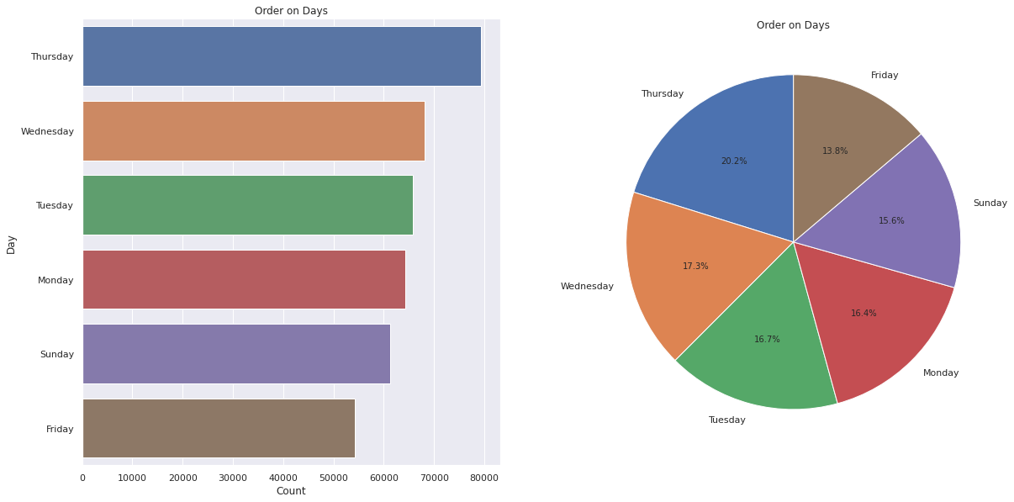
Order on different Days
Approx 20 percent order placed on Thursday which is most while least order placed on Friday i.e. 13.8 percent.

Slide 10
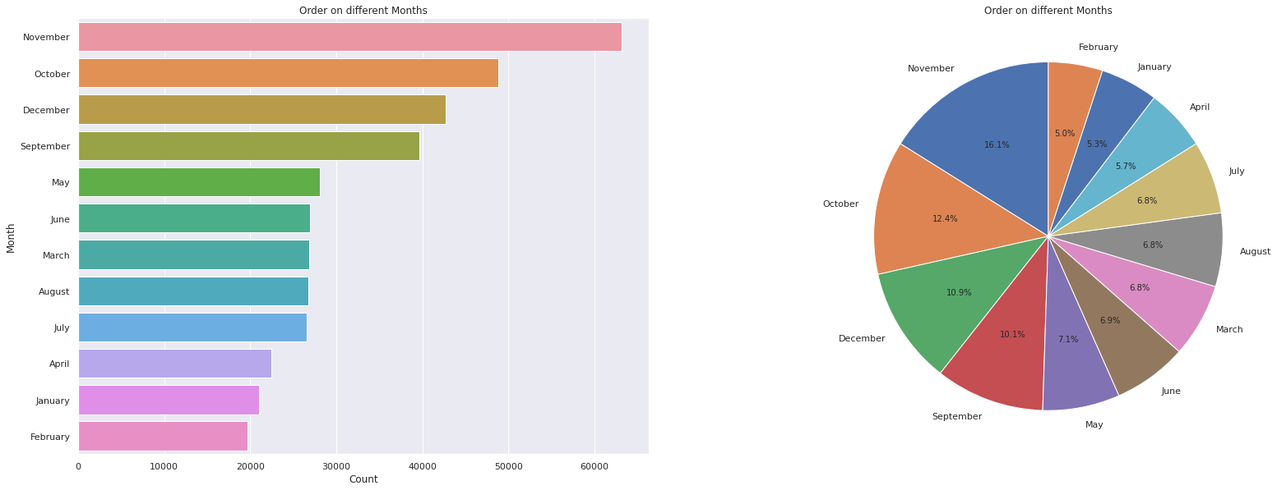
Orders in different Months
November had the most number of orders i.e. 16.1 percent and February had only 5 percent of orders which is lowest.

Slide 11
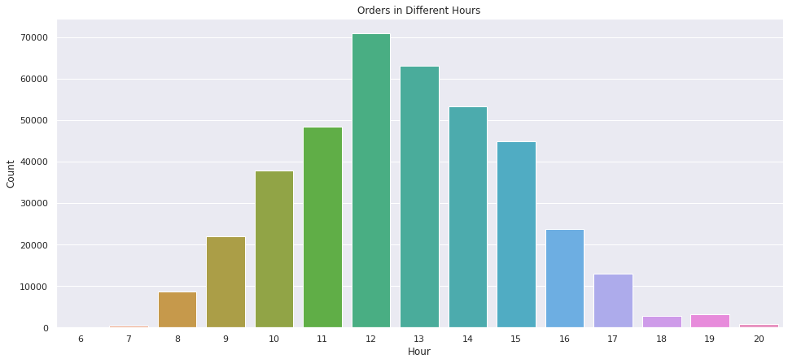
Orders on different Hours
We can see most orders are placed is in afternoon while orders after 8PM to 7AM are almost zero.

Slide 12
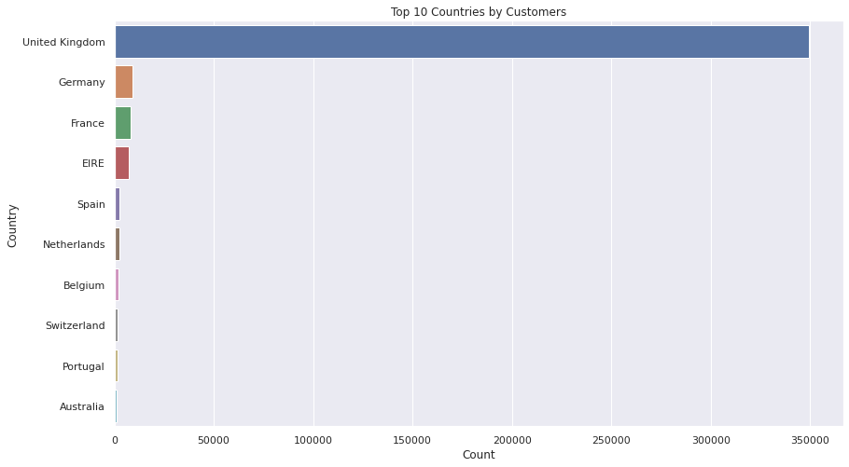
Countries
Most customers are from UK followed by Germany, France, EIRE and Spain.

Slide 13
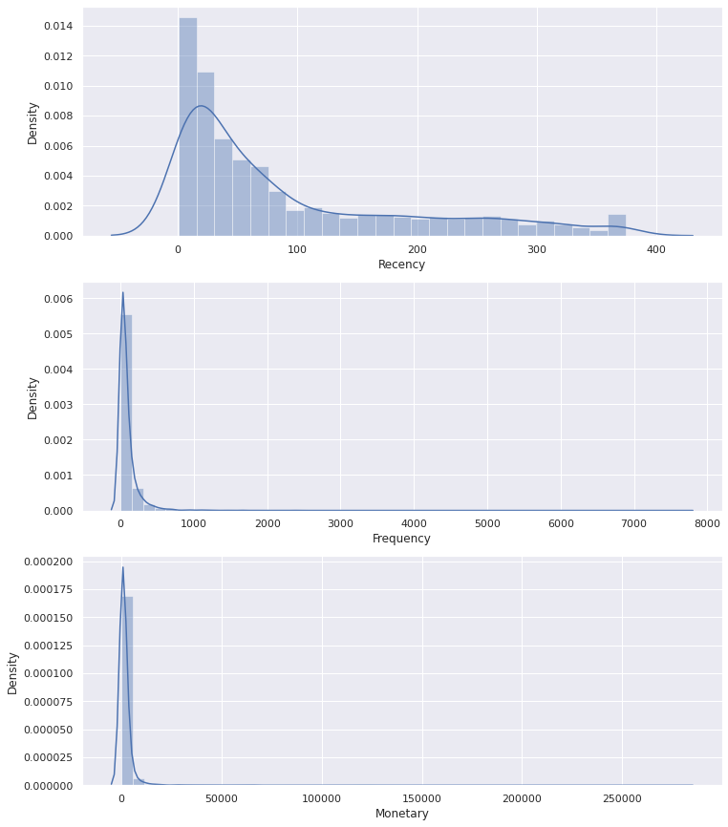
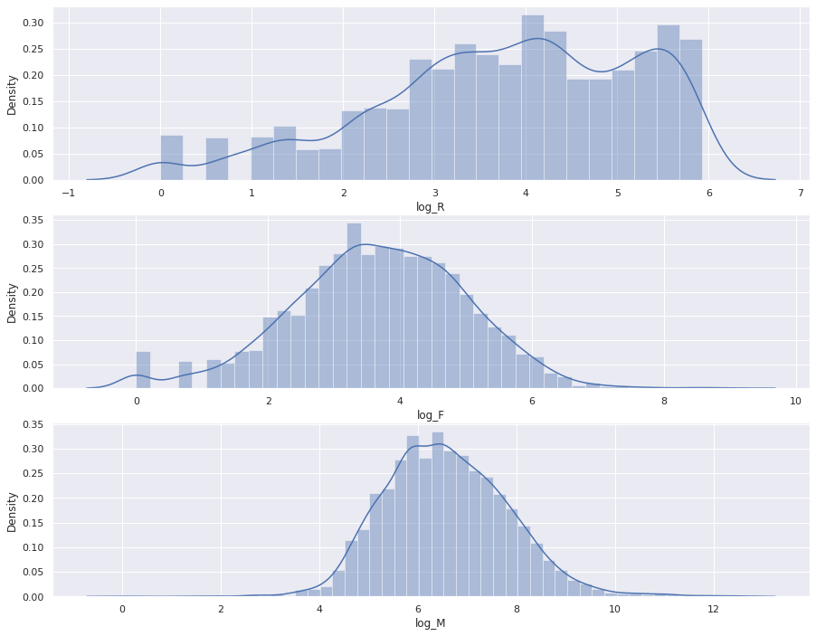
Recency, Frequency and Monetary
We can see all three are positively skewed.
Applied log transformation, all three are normalized to some extent.

Slide 14
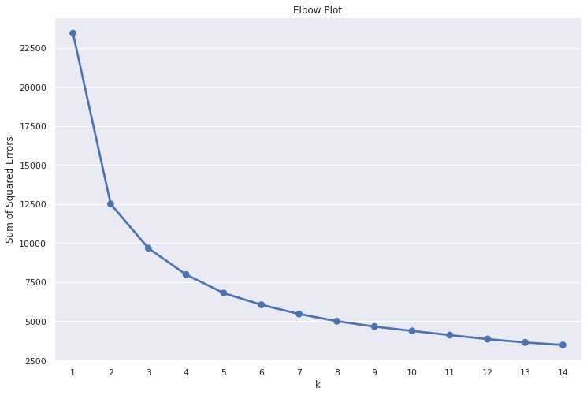
Elbow Plot
Drawn Elbow plot with the help of Recency, Frequency and Monetary to find optimal number of clusters. We can see the number of clusters can be taken as two or three.

Slide 15
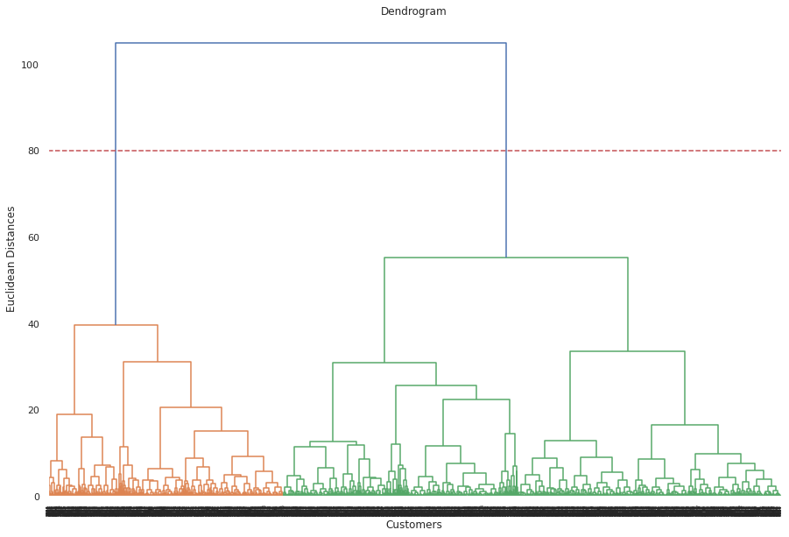
Dendrogram
Drawn dendrogram to find the optimal number of clusters, we can see threshold at 80 cutting two lines so we can take the number of cluster as two.

Slide 16
Silhouette Score
Silhouette Score
For number of clusters 4, the average Silhouette score is 0.30
For number of clusters 2, the average Silhouette score is 0.39`
For number of clusters 3, the average Silhouette score is 0.30
For number of clusters 5, the average Silhouette score is 0.28
For number of clusters 6, the average Silhouette score is 0.28
For number of clusters 7, the average Silhouette score is 0.26
For number of clusters 8, the average Silhouette score is 0.26
For number of clusters 9, the average Silhouette score is 0.25
For number of clusters 10, the average Silhouette score is 0.26
For number of clusters 11, the average Silhouette score is 0.26
For number of clusters 12, the average Silhouette score is 0.26
For number of clusters 13, the average Silhouette score is 0.26
For number of clusters 14, the average Silhouette score is 0.26
For number of clusters 15, the average Silhouette score is 0.25
From the average Silhouette score we can see the number of clusters can be taken as 2 or 3.

Slide 17
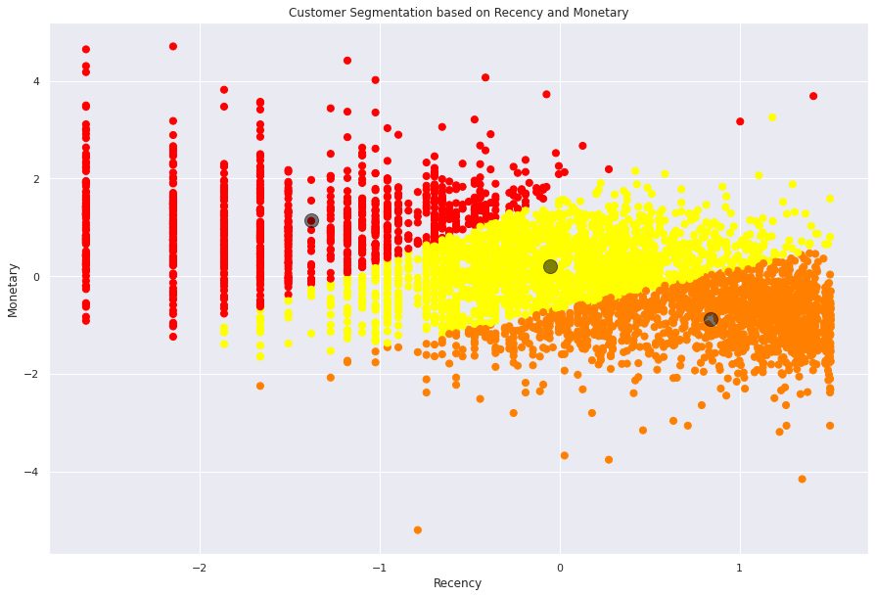
Recency and Monetary
Here I have taken the number of clusters as three, customers are well separated by these clusters. We can see when the recency is higher monetary is lower and in low recency, monetary is higher.

Slide 18
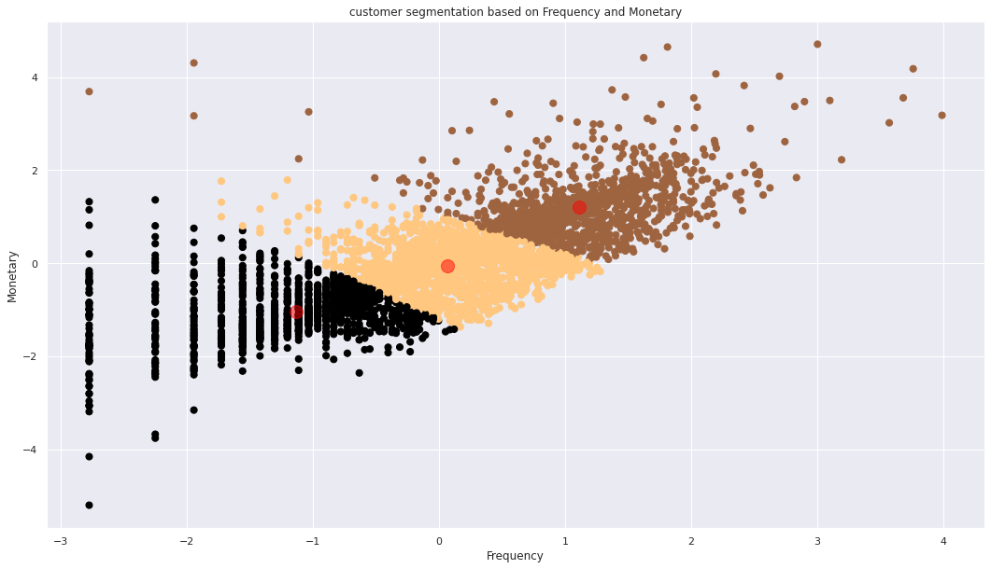
Frequency and Monetary
I have taken number of clusters as three, we can see customers are well separated by these clusters. Frequency and Monetary has positive relation i.e. when the frequency increases monetary value also increasing.

Slide 19
Conclusion
Total 2.21 % items were cancelled.
Top selling items are ‘White hanging heart t-light holder’, ‘Regency cakestand 3 tier’, ‘Jumbo bag red retrospot’ and ‘Assorted color bird ornament’.
Most orders are placed on Thursday i.e. 20.2% of the total orders while on Friday only 13.8% orders are placed.
November had the most number of orders i.e. 16.1 percent and February had only 5 percent of orders which is lowest.
Most orders are placed is in afternoon while orders after 8PM to 7AM are almost zero.
After viewing Elbow plot, Dendrogram and Silhouette score we saw that the number of clusters can be taken as two or three.
Applied two clustering algorithms Kmeans and Agglomerative clustering and taken number of clusters as three, customers are well separated in these customers.

Slide 20
Thank You

